Slide 1
A BRIEF INTRODUCTION TO Mobile Development Glynn RUdman

Slide 2
Who Am I?

Slide 3
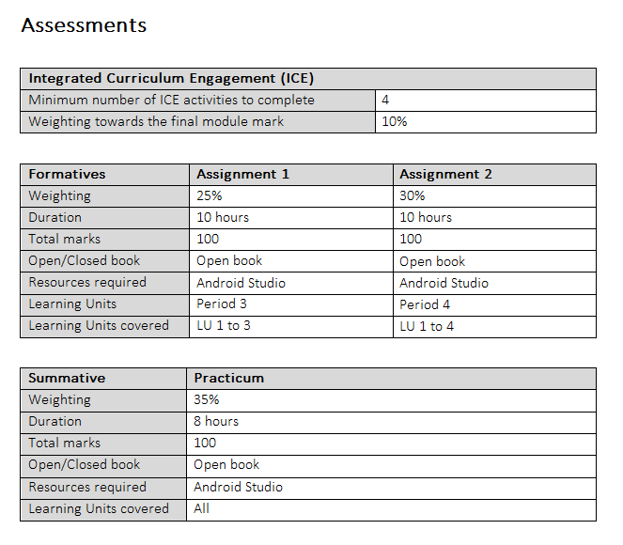
Module Breakdown

Slide 4
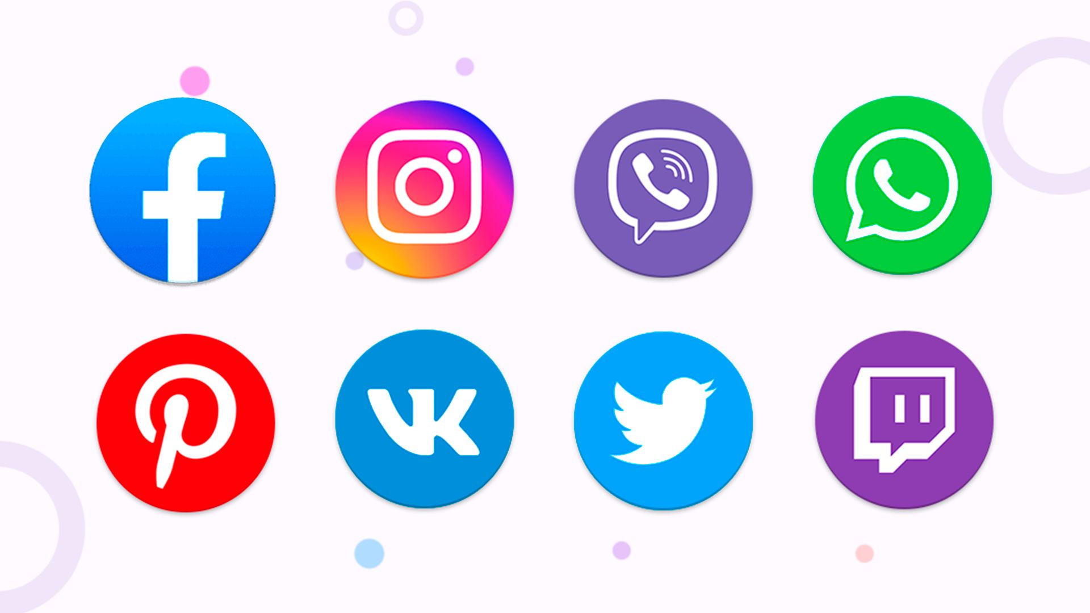
What was the FIRST app you used TODAY?
Notes:
Quick question - what was the first app you opened on your phone this morning? Maybe WhatsApp to check messages? Clock App to turn off your 11 alarms?
These apps have become such an integral part of our daily lives that we barely think about them anymore. But here's the exciting part - by the end of this module, you'll understand how these apps are built, and you'll be able to create your own. And the best part? It's not as mysterious as you might think.

Slide 5
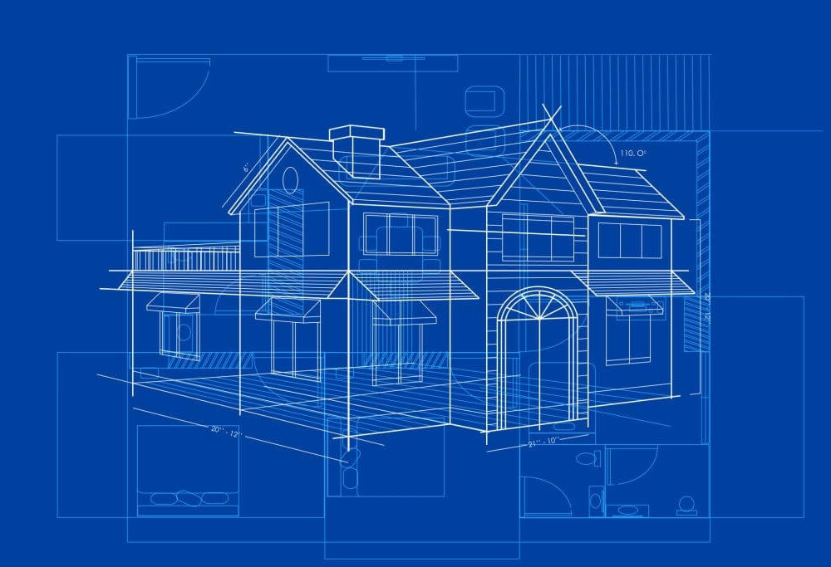
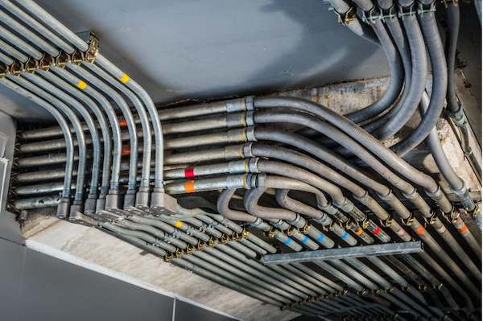
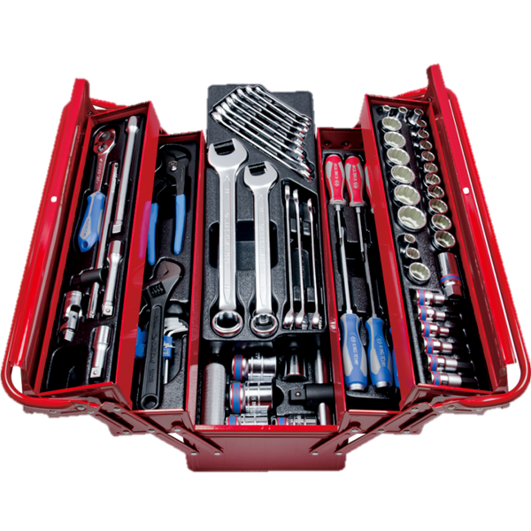
Building a House
Layout
Code
Android Studio
Notes:
Let's start with something familiar. When we build an app, it's very similar to building a house. Just like a house needs a blueprint, our app needs a layout.
Just as a house needs wiring and plumbing to make things work, our app needs code to make it function. And just like builders have their toolbox, we have Android Studio - our complete workshop for creating apps.
[Switch to Android Studio]
Speaking of which, let me show you what our workshop looks like. Don't worry about all these panels and buttons - when you're building a house, you don't need to understand every tool in the hardware store on day one. We'll learn them step by step.

Slide 6
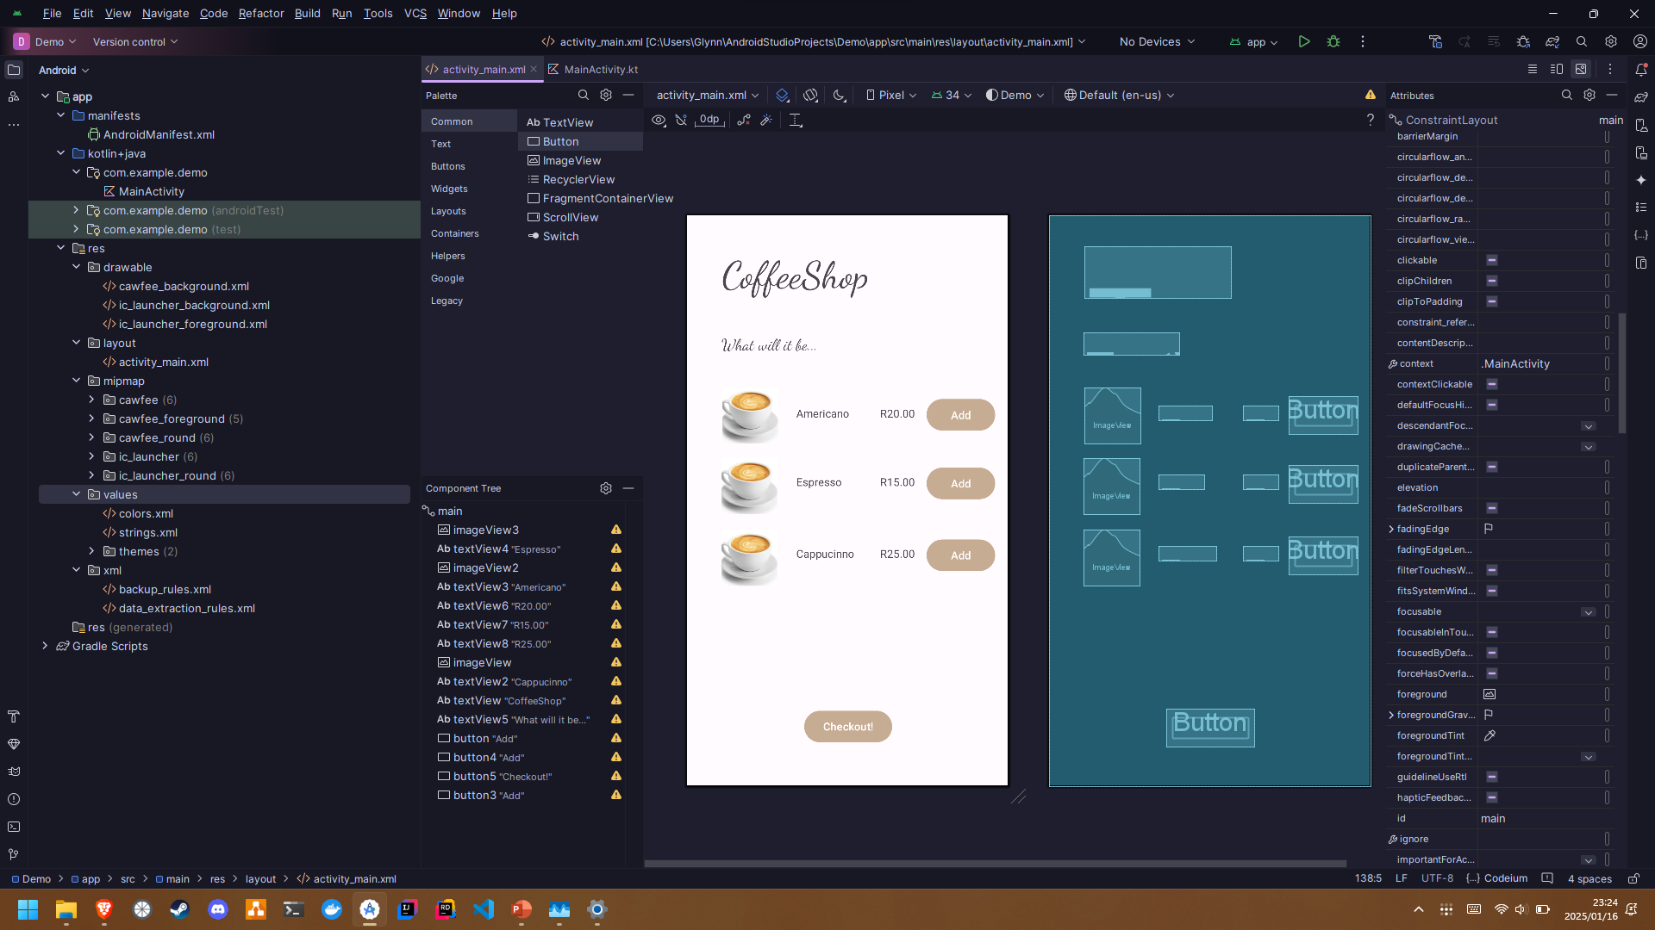
WHAT DOES OUR Workshop LOOK LIKE?
“Furniture”
(Objects)
Live Preview
“Rooms” (Files)
“Blueprint”
(Layout)
“Toolbox” (Android Studio)
“Trimmings” (Attributes)
Notes:
Firstly, our trusty toolbox.

Slide 7

Most importantly, The EMULATOR!
What is it though?
A virtual phone, right on your PC!
Very similar to the virtual machine its running on.
Allows us to run the apps we make for Android, on our Windows computers.
An Android app, running on a virtual Android phone, running on a virtual Windows computer, running on a Windows computer!

Slide 8
The Cycle Begins
Design 🎨
Build 🛠️
Launch 📈
Imagine 💭
Notes:
So, in just these few minutes, we've seen how building an app is a lot like building a house - we need a design, we need the right tools, and we build it piece by piece. Over this module, you'll learn to design beautiful app screens, make them interactive, and eventually, publish them for others to use.
Remember how we started with that question about your morning apps? Soon, you might be building the next app that people check first thing in their day.

